Slide 1


MindSpore and ONNX
Zhipeng Huang

Slide 2
Contents
01
MindSpore Introduction
02
MindSpore and ONNX/MLIR
03
MindSpore and ONNX Training
04
Call For Participation

Slide 3



MindSpore Introduction
MindSpore is a new open source deep learning training/inference framework that could be used for mobile, edge and cloud scenarios.
MindSpore is designed to provide development experience with friendly design and efficient execution for the data scientists and algorithmic engineers, native support for Ascend AI processor, and software hardware co-optimization.
At the meantime MindSpore as a global AI open source community, aims to further advance the development and enrichment of the AI software/hardware application ecosystem.
https://www.mindspore.cn
https://www.gitee.com/mindspore
https://www.github.com/mindspore-ai

Slide 4
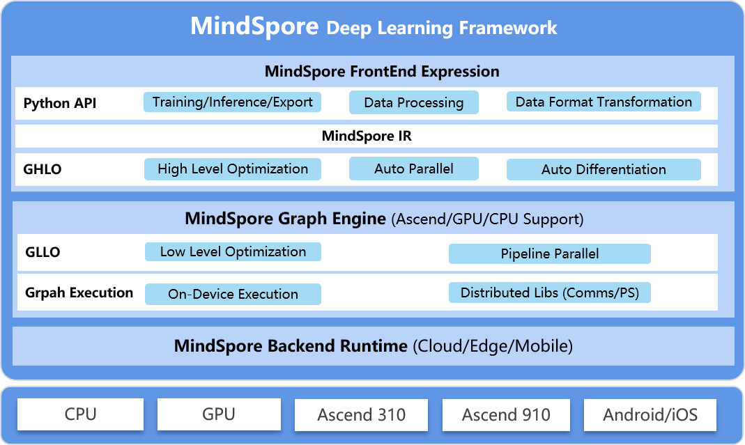
Overview

Slide 5
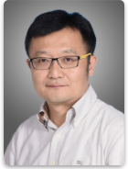
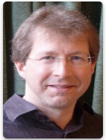
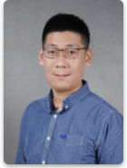

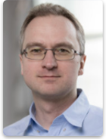
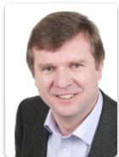
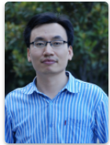


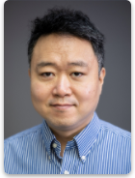

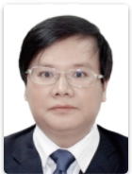

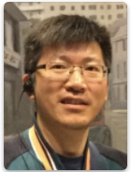
Technical Steering Committee
14 members from various universities/institutions/companies
that forms an open and global technical governing body

Slide 6
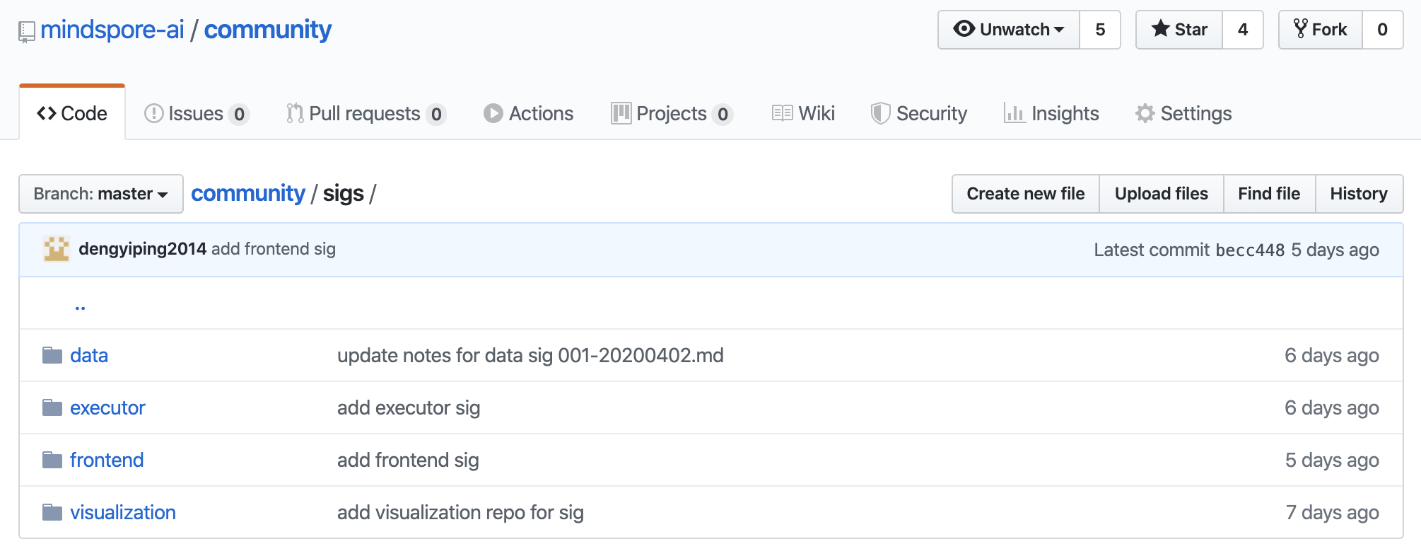
SIG/WG
SIGs
FrontEnd,
Compiler
Executor
ModelZoo
Data
GraphEngine
Visualization
Security
...
WGs
Documentation
Infrastructure
...
Open Developement

Slide 7

Community partners
Open Collaboration

Slide 8
Contents
01
MindSpore Introduction
02
MindSpore and ONNX/MLIR
03
MindSpore and ONNX Training
04
Call For Participation

Slide 9
MindSpore ONNX Exporter Introduction
MindSpore
save as
ONNX model
FrontEnd Expression
train.export()
ONNX
Exporter
model.onnx
ONNX Runtime
train
Graph Engine
(Ascend/GPU/CPU)
Use MindSpore model train API to perform model training with saving checkpoint parameters
Load model parameters into the network to be exported (such like LeNet)
Call train.export() to convert MindSpore model to ONNX model
Perform model inference on ONNX Runtime

Slide 10
MindSpore ONNX Exporter Support
MindSpore Operator | ONNX Operator | MindSpore Operator | ONNX Operator
TensorAdd | Add | BatchNorm | BatchNormalization
Mul | Mul | Reshape | Reshape
ReLU | Relu | ReduceMean | ReduceMean
Sigmoid | Sigmoid | Cast | Cast
Flatten | Flatten | PReLU | PRelu
Squeeze | Squeeze | Argmax | ArgMax
Conv2D | Conv | SimpleMean | AveragePool
BiasAdd | Add | MaxPool | MaxPool
MatMul | Gemm | AvgPool | AveragePool
Operator Support: 18
Network Support: LeNet、ResNet50、AlexNet
Roadmap: More operators and networks (in ModelZoo) are WIP

Slide 11
Exploring MindSpore and ONNX-MLIR (Idea)
MindSpore
save as
ONNX model
ONNX Frontend
ONNX Dialect
FrontEnd Expression
train.export()
ONNX
Exporter
MLIR Dialect
（Standard/Transformation/Affine Dialect etc.）
model.onnx
LLVM Dialect
LLVM+
ONNX-MLIR
https://github.com/onnx/onnx-mlir

Slide 12
Contents
01
MindSpore Introduction
02
MindSpore and ONNX/MLIR
03
MindSpore and ONNX Training
04
Call For Participation

Slide 13
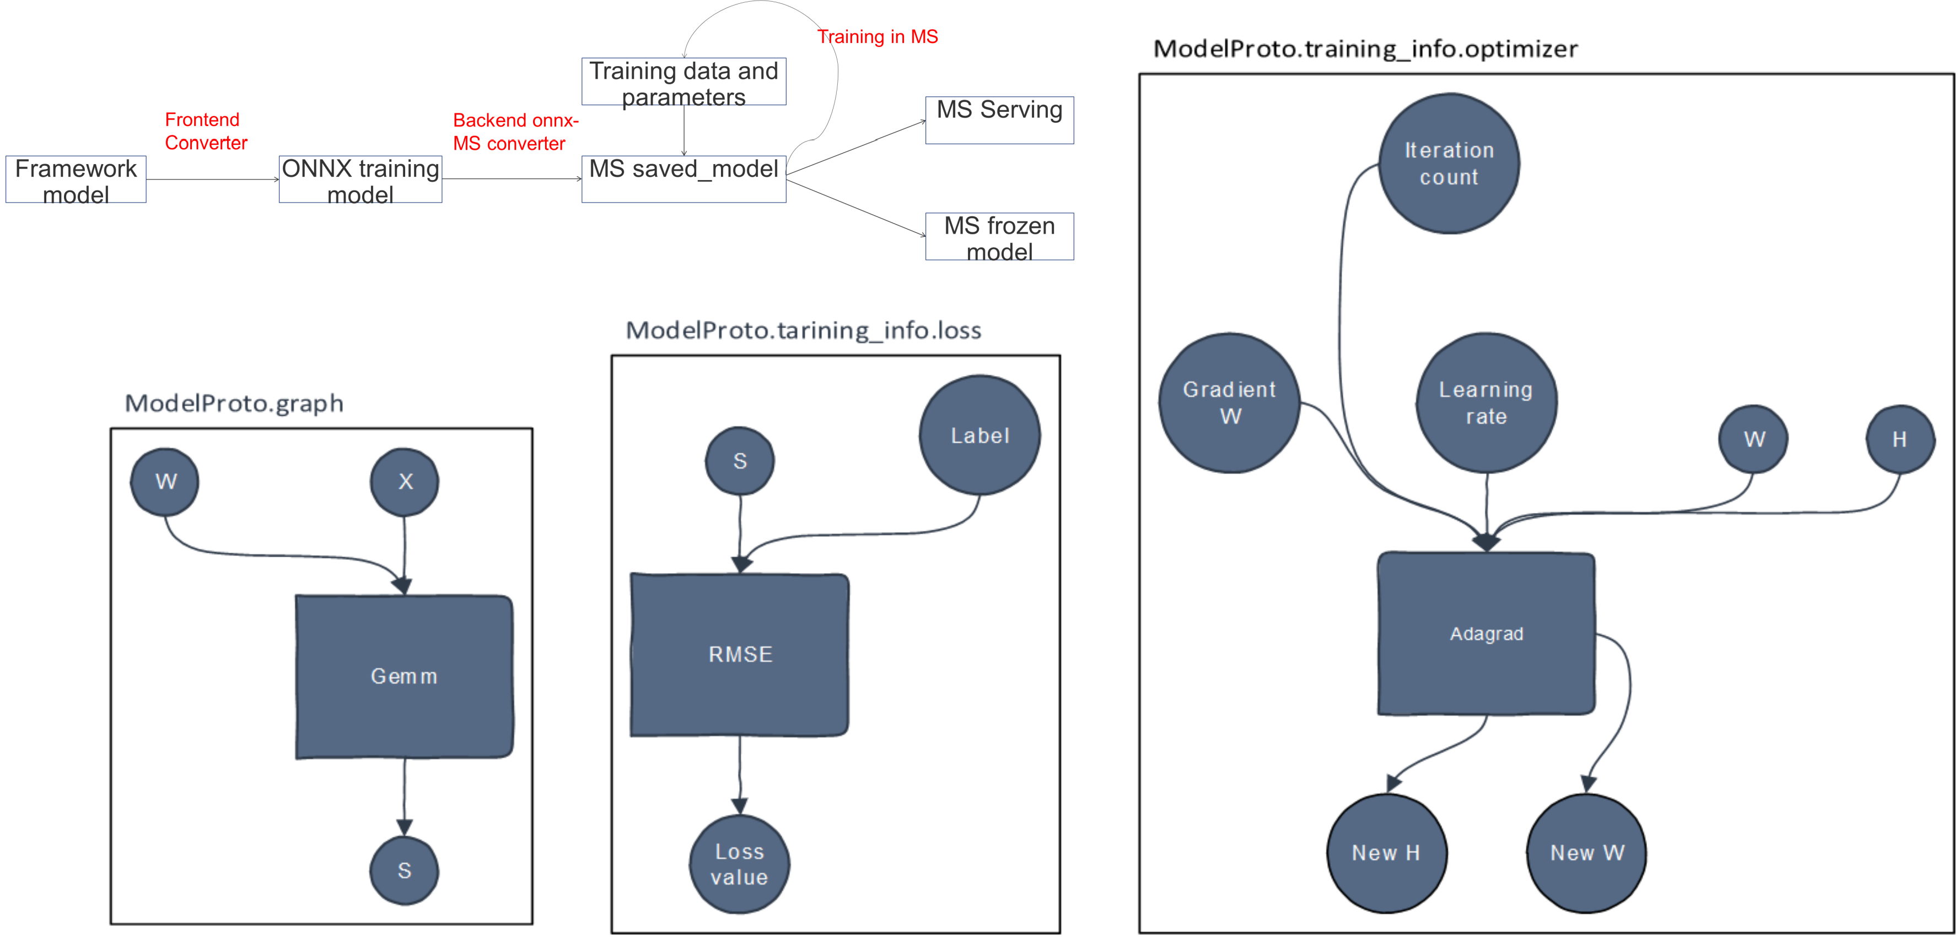
Exploring MindSpore and ONNX Training (Idea)

Slide 14
Contents
01
MindSpore Introduction
02
MindSpore and ONNX/MLIR
03
MindSpore and ONNX Training
04
Call For Participation

Slide 15
Call For Participation
Checkout the Code
https://gitee.com/mindspore (main development)
https://github.com/mindspore-ai (mirror)
Try with docker
docker pull mindspore/mindspore-cpu:0.1.0-alpha
docker pull mindspore/mindspore-cuda10.1:0.1.0-alpha
docker pull mindspore/mindspore-cuda9.2:0.1.0-alpha
Discussion (you can initiate an ONNX WG !)
Slack:https://join.slack.com/t/mindspore/shared_invite/enQtOTcwMTIxMDI3NjM0LTNkMWM2MzI5NjIyZWU5ZWQ5M2EwMTQ5MWNiYzMxOGM4OWFhZjI4M2E5OGI2YTg3ODU1ODE2Njg1MThiNWI3YmQ
Mailing list: https://mailweb.mindspore.cn/postorius/lists/mindspore-discuss.mindspore.cn/

Slide 16



